Slide 1
Neural Networks
Dhaval Lunagariya

Slide 2
Agenda
Machine Learning Basics
Supervised vs Unsupervised Learning
AI vs ML vs DL
Slope of Line
Differentiation Chain Rule
Components of NN
Forward Propagation
Loss Function
Backward Propagation
Forward Propagation
Bias
Learning Rate

Slide 3
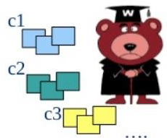
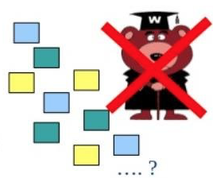
Supervised vs Unsupervised
Supervised
Knowledge of output - learning with the presence of an “expert” / teacher
Data is labelled with a class or value
Goal : predict class or vale
Eg. Neural Network, Support Vector machine, Decision Trees, Classification
Unsupervised
No knowledge of output class or value
Data is unlabelled or value unknown
Goal : Determine data patterns/groupings
Self-guided learning algorithm
Internal self-evaluation against some criteria
Eg. k-means, clusterring
source : researchgate.net

Slide 4
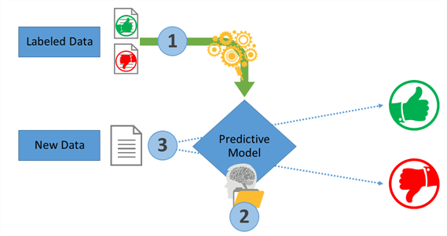
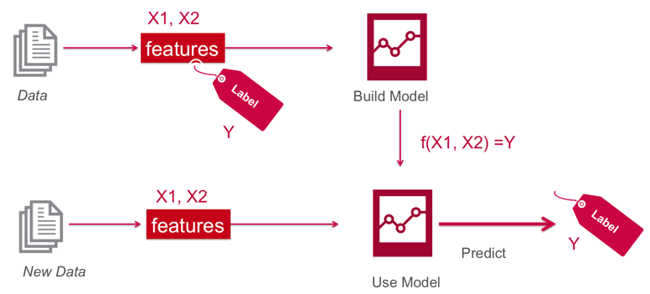
Supervised Machine Learning
source: symantec.com | mapr.com

Slide 5
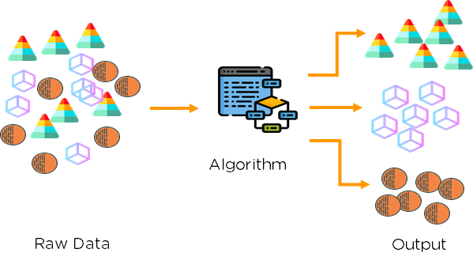
Unsupervised Learning

Slide 6
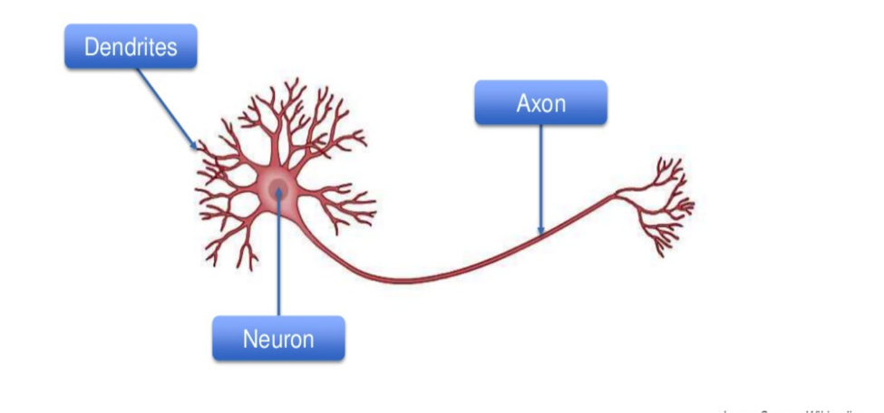
Human Brain

Slide 7
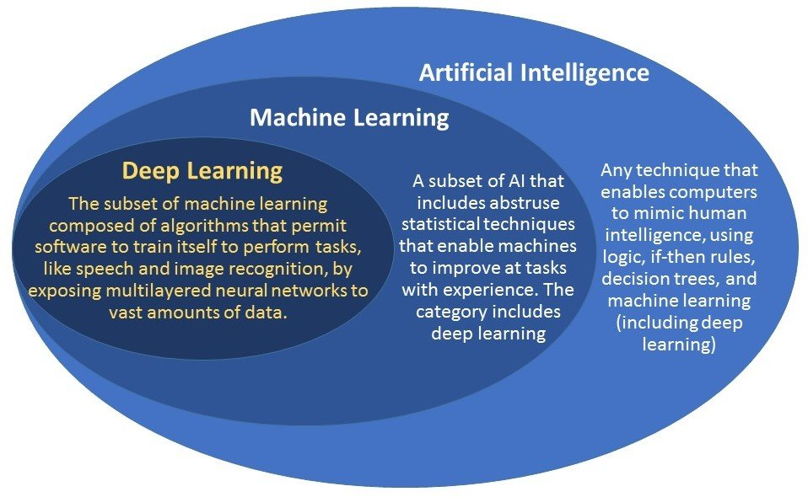
AI vs ML vs DL
Notes:
AI — AI that is skilled at one specific task. This is different from AGI — AGI is the intelligence of a machine that could successfully perform a range of tasks intellectual task that a human being can. On the other hand, Superintelligent AI takes things a step further. As Nick Bostrom describes it, this is “an intellect that is much smarter than the best human brains in practically every field, including scientific creativity, general wisdom, and social skills.” In other words, it is when the machines have outfoxed us.
Machine learning is a subset of AI. The theory is simple, machines take data and ‘learn’ for themselves. It is currently the most promising tool in the AI pool for businesses. Machine learning systems can quickly apply knowledge and training from large datasets to excel at facial recognition, speech recognition, object recognition, translation, and many other tasks. Machine learning allows a system to learn to recognize patterns on its own and make predictions, contrary to hand-coding a software program with specific instructions to complete a task.
While Deep Blue and DeepMind are both types of AI, Deep Blue was rule-based, dependent on programming — so it was not a form of machine learning. DeepMind, on the other hand — beat the world champion in Go by training itself on a large data set of expert moves.
That is, all machine learning counts as AI, but not all AI counts as machine learning.
Deep learning is a subset of machine learning. Deep artificial neural networks are a set of algorithms reaching new levels of accuracy for many important problems, such as image recognition, sound recognition, recommender systems, etc.
It uses some machine learning techniques to solve real-world problems by tapping into neural networks that simulate human decision-making. Deep learning can be costly and requires huge datasets to train itself. This is because there are a huge number of parameters that need to be understood by a learning algorithm, which can primarily yield a lot of false-positives. For example, a deep learning algorithm could be trained to ‘learn’ how a dog looks like. It would take an enormous dataset of images for it to understand the minor details that distinguish a dog from a wolf or a fox.
Deep learning is part of DeepMind’s notorious AlphaGo algorithm, which beat the former world champion Lee Sedol in 4 out of 5 games of Go using deep learning in early 2016. Google said, “the way the deep learning system worked was by combining Monte-Carlo tree search with deep neural networks that have been trained by supervised learning, from human expert games, and by reinforcement learning from games of self-play.
Ref : https://www.geospatialworld.net/blogs/difference-between-ai%EF%BB%BF-machine-learning-and-deep-learning/

Slide 8
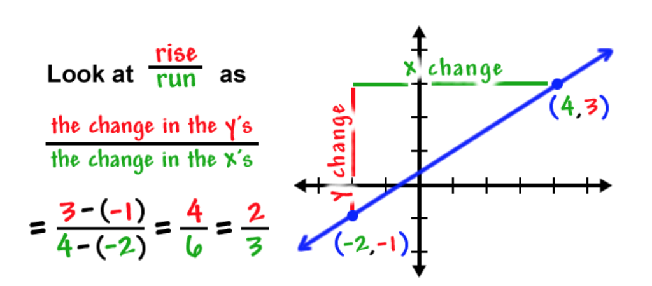
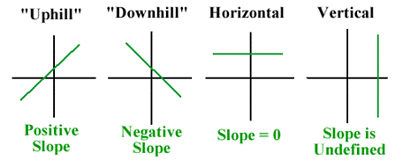
Slope of Line
Notes:
Ref : https://www.coolmath.com/algebra/08-lines/06-finding-slope-line-given-two-points-01
http://www.montereyinstitute.org/courses/DevelopmentalMath/COURSE_TEXT2_RESOURCE/U13_L2_T1_text_final.html

Slide 9
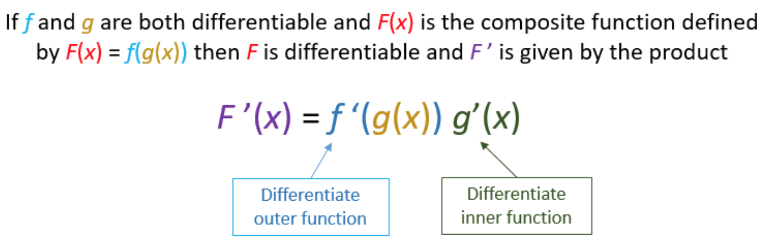
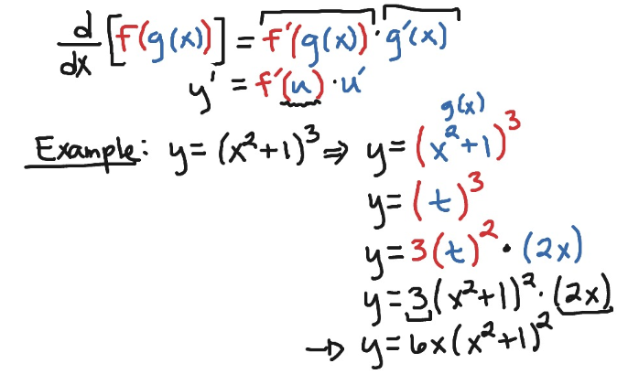
Chain Rule
Notes:
Ref : https://www.onlinemathlearning.com/chain-rule.html
Chain Rule : https://www.showme.com/sh/?h=bWnPXpQ

Slide 10

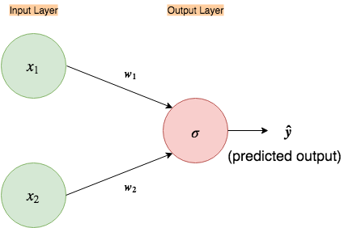

Simple input-output neural network
Input nodes
Weights

Slide 11

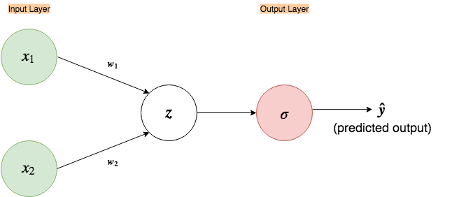
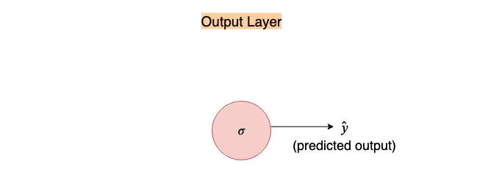
Expanded neural network
Linear operation
`Input times weights and activate`

Slide 12
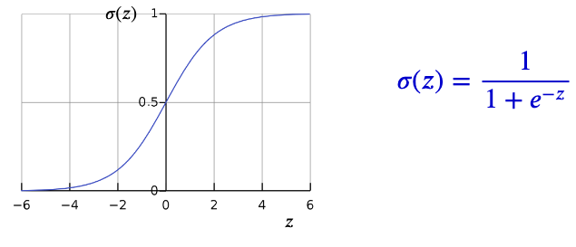
Sigmoid/logistic function
Other Popular Activation Functions:
Tanh — Hyperbolic tangent
ReLu -Rectified linear units
Notes:
Sigmoid is one of the many “activations functions” used in neural networks. The job of an activation function is to change the input to a different range. For example, if z > 2 then, σ(z) ≈ 1 and similarly, if z < -2 then, σ(z) ≈ 0. So, the sigmoid function squashes the output range to (0, 1) (this ‘()’ notation implies exclusive boundaries; never completely outputs 0 or 1 as the function asymptotes, but reaches very close to boundary values)
Ref: https://towardsdatascience.com/activation-functions-and-its-types-which-is-better-a9a5310cc8f

Slide 13
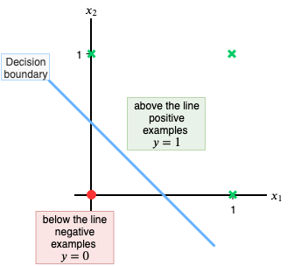
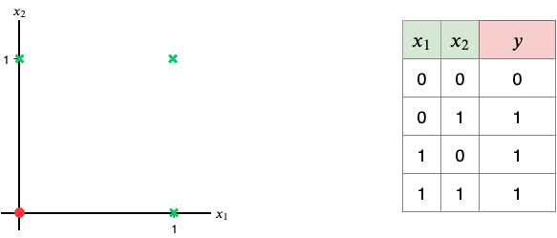
OR gate
Notes:
The data above represents an OR gate(output 1 if any input is 1). Each row of the table represents an ‘example’ we want our neural network to learn from. After learning from the given examples we want our neural network to perform the function of an OR gate; given the input features, x₁ and x₂, try to output the corresponding y(also called ‘label’). I have also plotted the points on a 2-D plane so that it is easy to visualize(green crosses represent points where the output(y) is 1 and the red dot represents the point where the output is 0).
This OR-gate data is particularly interesting, as it is linearly separable i.e. we can draw a straight line to separate the green cross from the red dot.

Slide 14
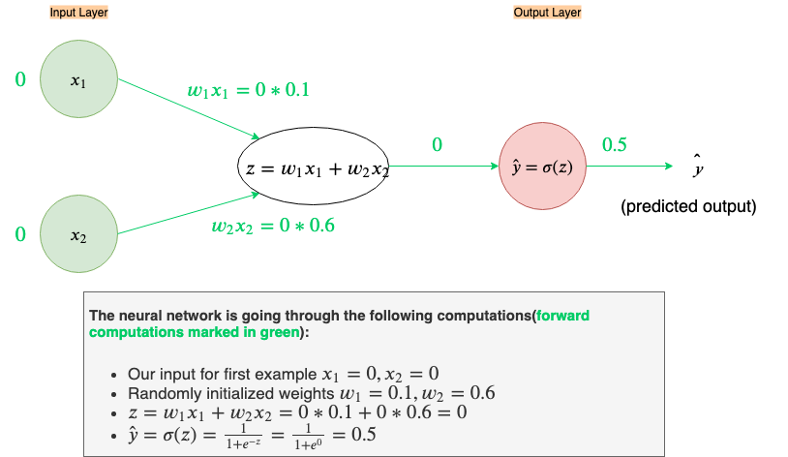
Forward propagation of first input
x₁=0
x2=0
Randomly selected
w1 =0.1
w2=0.6
Notes:
With our current weights, w₁= 0.1 and w₂ = 0.6, our network’s output is a bit far from where we’d like it to be. The predicted output, ŷ, should be ŷ≈0 for x₁=0 and x₂=0, right now its ŷ=0.5.
Ref: https://machinelearningmastery.com/why-initialize-a-neural-network-with-random-weights/

Slide 15
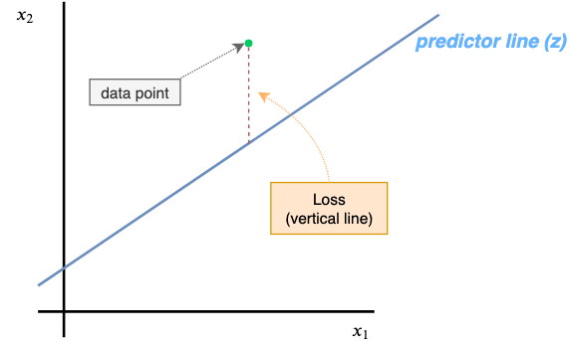
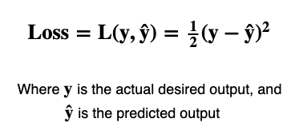
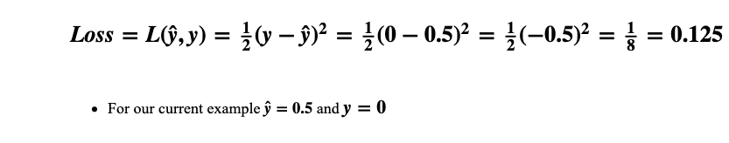
Loss Function
Notes:
The Loss Function is a simple equation that tells us how far our neural network’s predicted output(ŷ) is from our desired output(y), for ONE example, only.
Taking the square keeps everything nice and positive and the fraction (1/2) is there so that it cancels out when taking the derivative of the squared term (it is common among some machine learning practitioners to leave the fraction out).

Slide 16
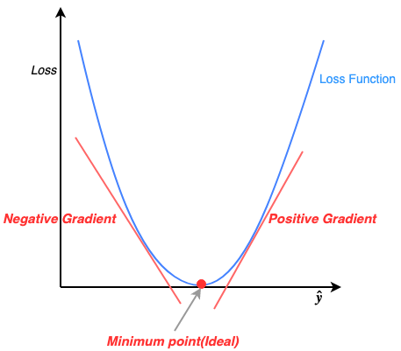
Loss function visualized

Slide 17
Learn all the weights: Gradient descent
Error at:
original weight
Weight
Notes:
Ref : https://docs.google.com/presentation/d/1AAEFCgC0Ja7QEl3-wmuvIizbvaE-aQRksc7-W8LR2GY/edit#slide=id.p

Slide 18
Learn all the weights: Gradient descent
Error at:
lower weight
original weight
Weight

Slide 19
Learn all the weights: Gradient descent
Error at:
lower weight
original weight
higher weight
Weight

Slide 20
Numerically calculating the gradient is very expensive

Slide 21
Calculate the gradient (slope) directly
Error at:
original weight
Weight

Slide 22
Slope
Error at:
change in
weight = +1
original weight
Weight

Slide 23
Slope
Error at:
change in
weight = +1
original weight
move along
the curve
Weight

Slide 24
Slope
Error at:
change in
weight = +1
original weight
change in
error = -2
Weight

Slide 25
Slope
slope = change in error
change in weight
Error at:
change in
weight = +1
original weight
change in
error = -2
Weight

Slide 26
Slope
slope = change in error
change in weight
= ∆ error
∆ weight
= d(error)
d(weight)
= ∂e
∂w
= -2 = -2
+1
Error at:
change in
weight = +1
original weight
change in
error = -2
Weight

Slide 27
Slope
You have to know your error function.
For example:
error = weight ^2
Error at:
original weight
Weight
-1
0
+1

Slide 28
Slope
You have to know your error function.
For example:
error = weight ^2
∂e = 2 * weight
∂w
= 2 * -1
= -2
Error at:
original weight
Weight
-1
0
+1

Slide 29
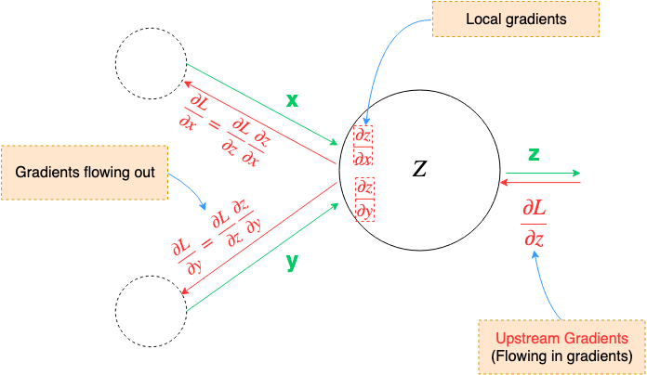
Gradient Flow
Notes:
at each node, we only have our local gradient computed(partial derivatives of that node), then during backpropagation, as we are receiving numerical values of gradients from upstream, we take these and multiply with local gradients to pass them on to their respective connected nodes.

Slide 30
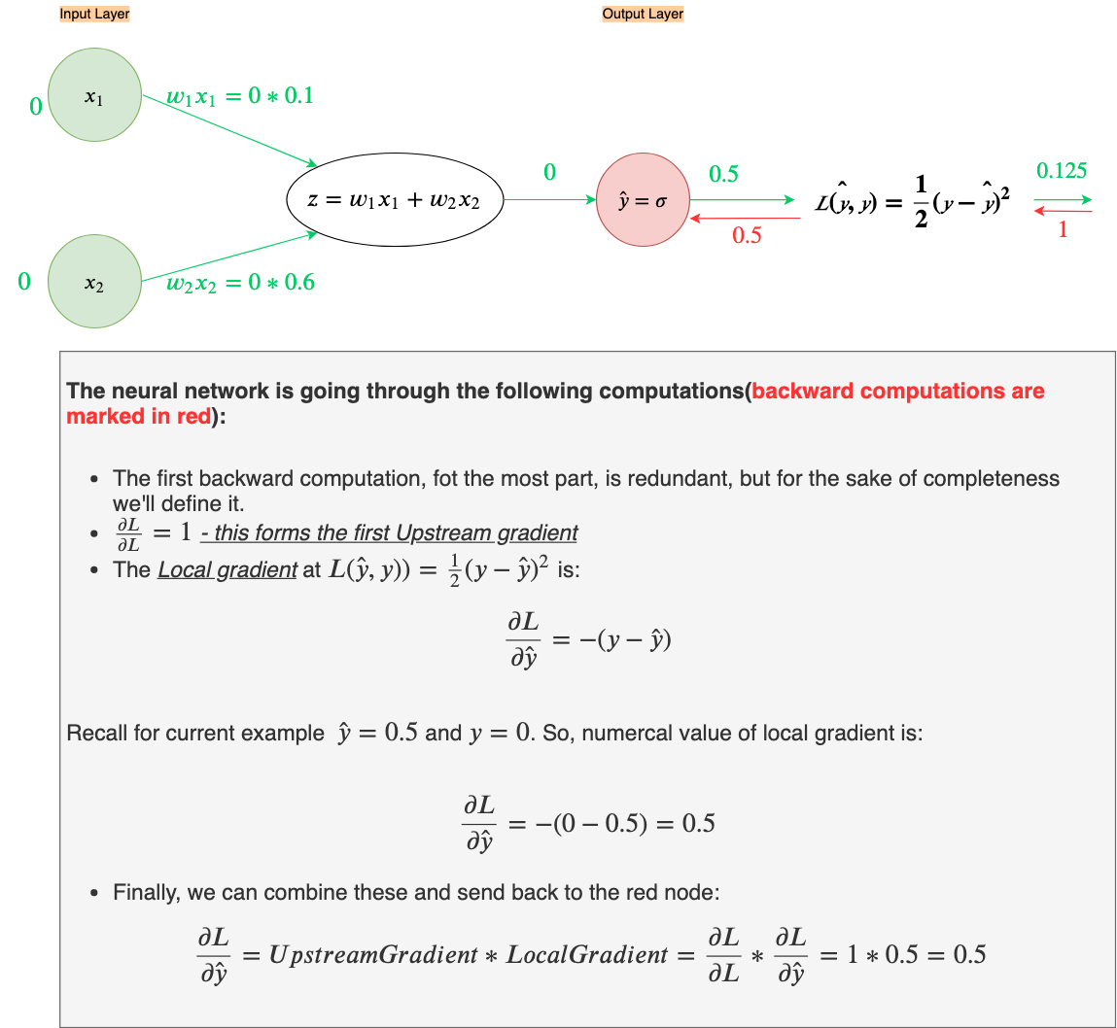

Slide 31
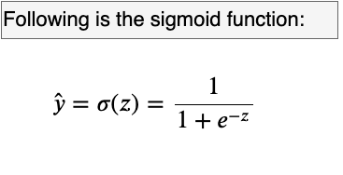
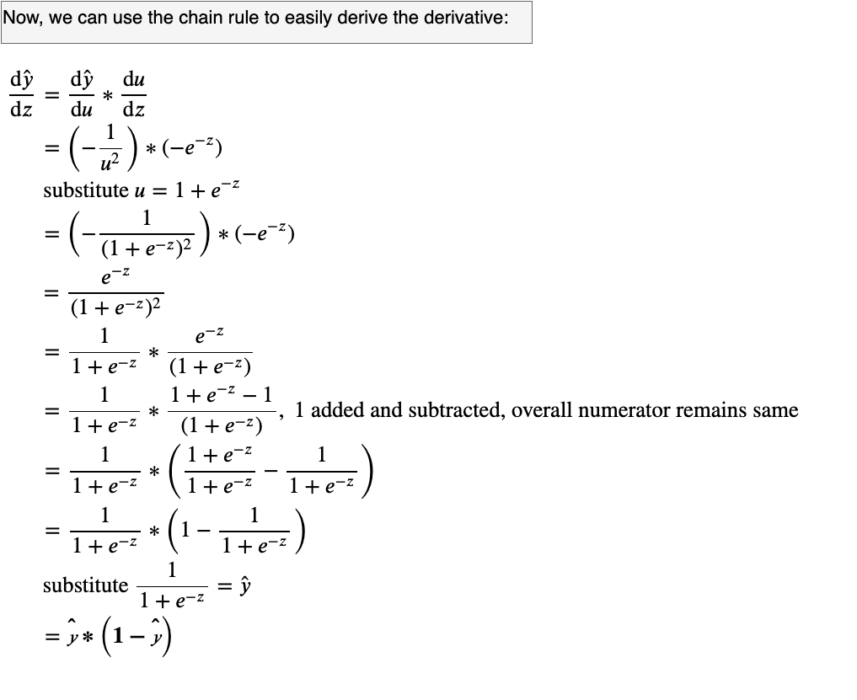
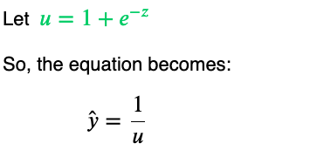
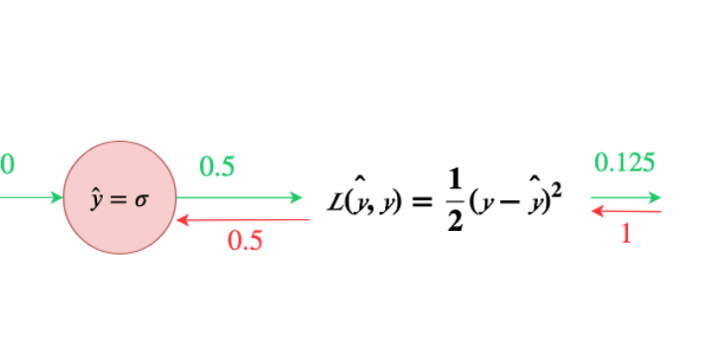
This will be used in next backward calculation

Slide 32
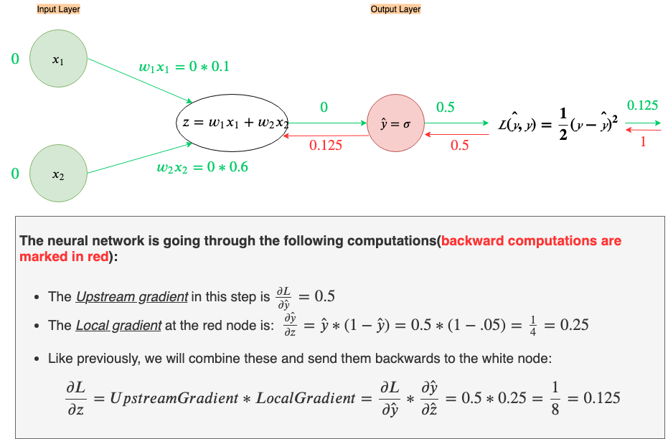

Slide 33
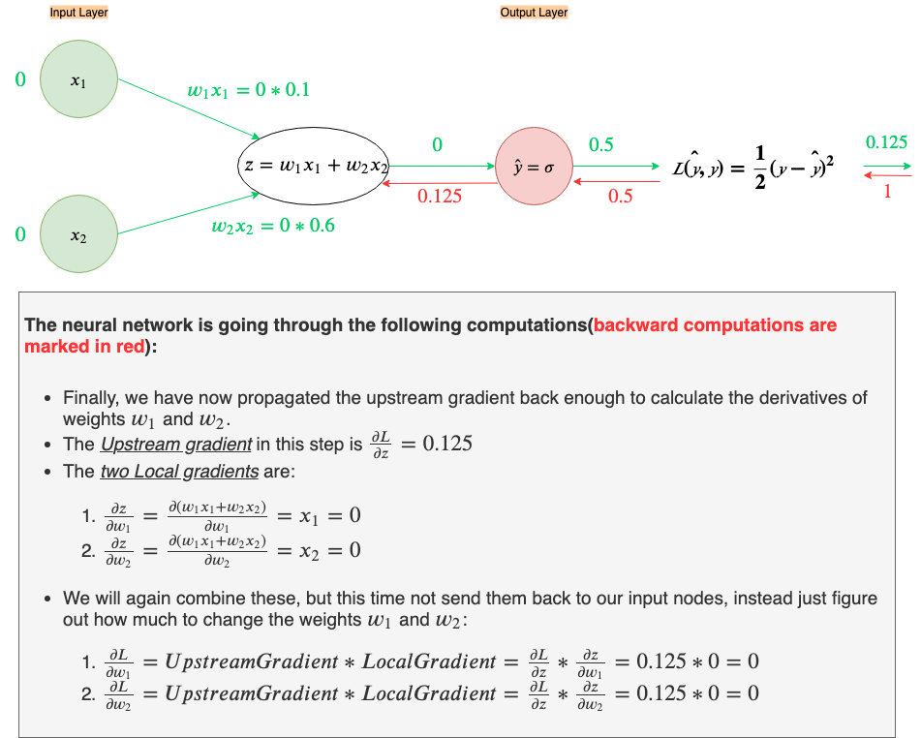
Notes:
Notice something weird? The derivatives to the Loss with respect to the weights,w₁ & w₂, are ZERO! We can’t increase or decrease the weights if their derivatives are zero. So then, how do we get our desired output in this instance if we can’t figure out how to adjust the weights? The key thing to note here is that the local gradients (∂z/∂w₁ and ∂z/∂w₂) are x₁ and x₂, both of which, in this example, happens to be zero (i.e. provide no information)
This brings us to the concept of bias.

Slide 34
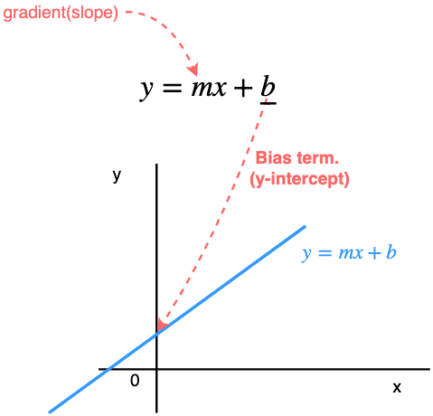
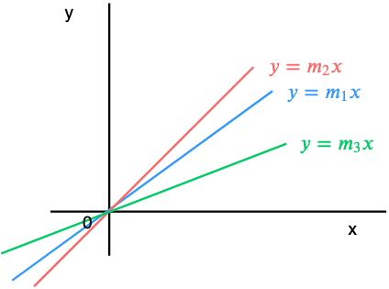
Bias
Notes:
Here b is the bias term. Intuitively, the bias tells us that all outputs computed with x(independent variable) should have an additive bias of b. So, when x=0(no information coming from the independent variable) the output should be biased to just b.
Note that without the bias term a line can only pass through the origin(0, 0) and the only differentiating factor between lines would then be the gradient m.

Slide 35
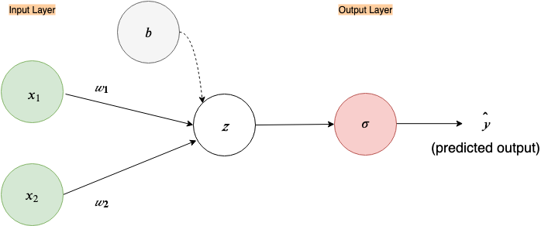
Expanded NN with bias node
Notes:
In neural network literature, every layer, except the input layer, is assumed to have a bias node, just like the linear node, so this node is also often omitted in figures.

Slide 36
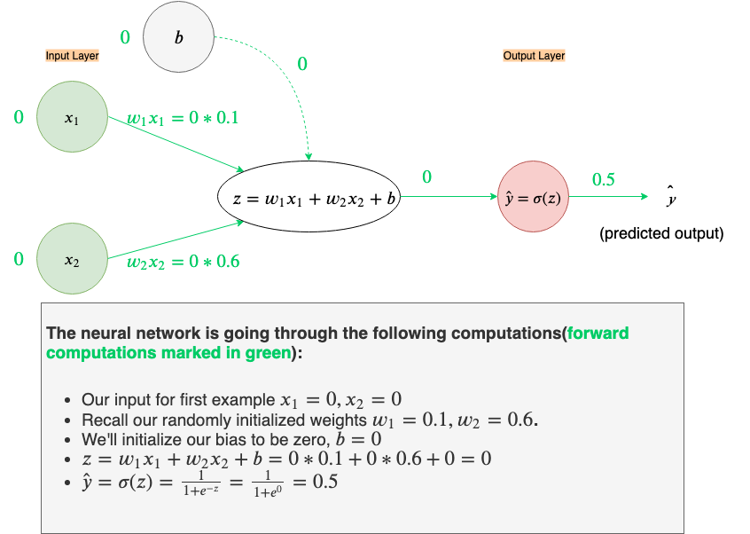

Slide 37
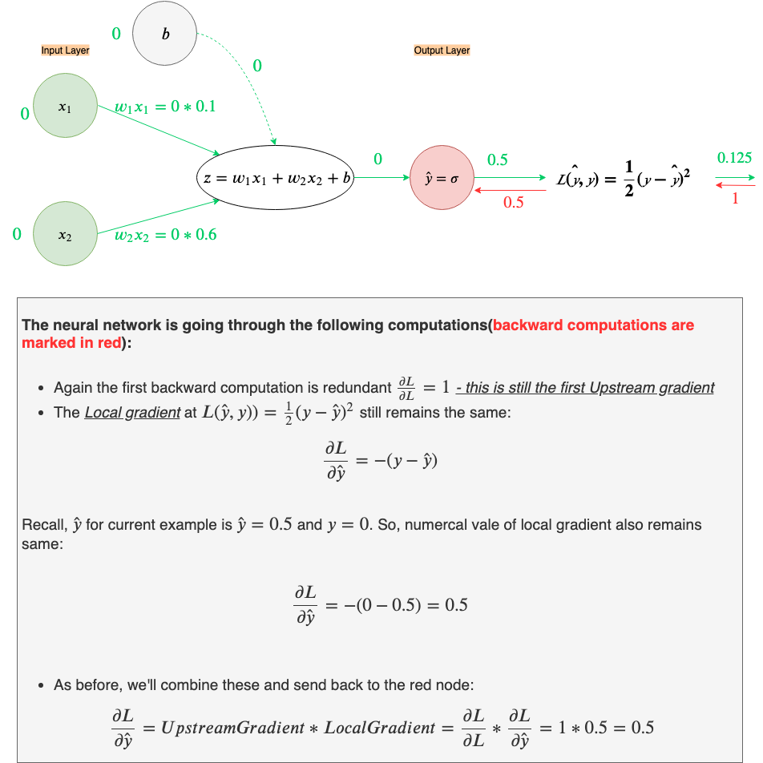

Slide 38
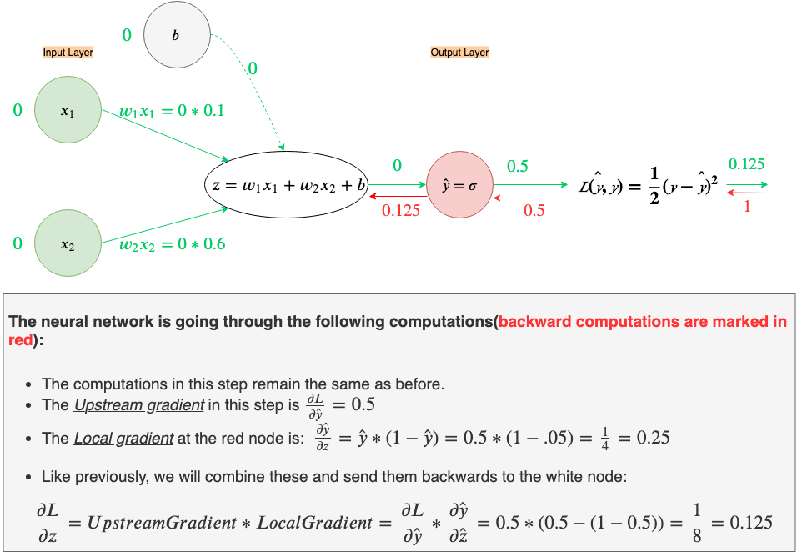

Slide 39
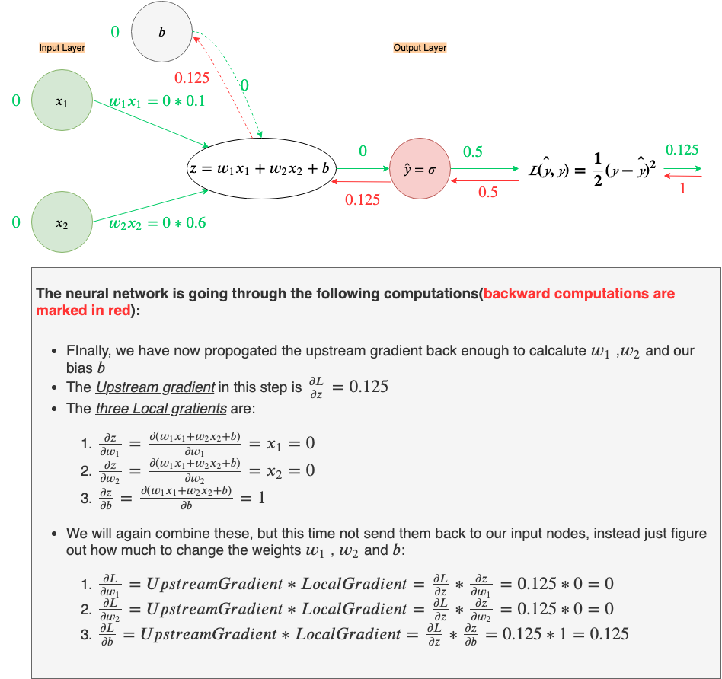
Notes:
we just figured out how much to adjust the bias. Since the derivative of bias(∂L/∂b) is positive 0.125, we will need to adjust the bias by moving in the negative direction of the gradient(recall the curve of the Loss function from before). This is technically called gradient descent, as we are “descending” away from the sloping region to a flat region using the direction of the gradient. Let’s do that.

Slide 40
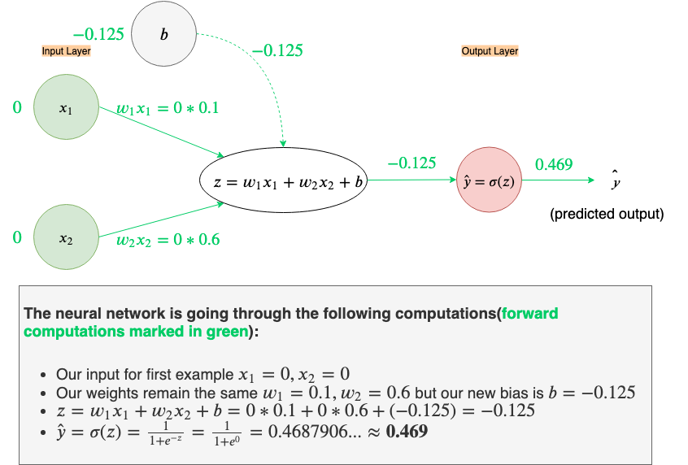
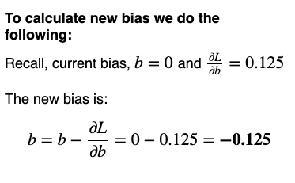
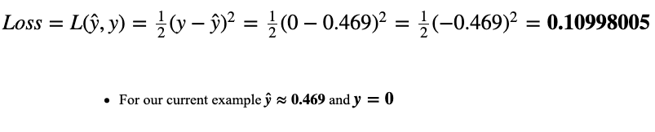
Loss after newly calculated bias :

Slide 41
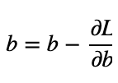
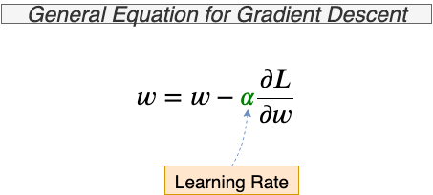
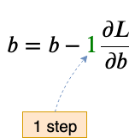
Learning Rate
Equation for updating bias
Equation for updating bias showing step

Slide 42
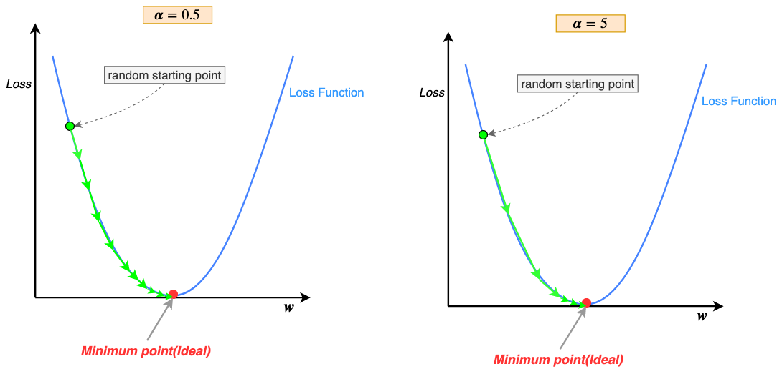
Effect of Learning Rate
Notes:
The keen-eyed may have noticed that gradient descent steps(green arrows) keep getting smaller as we get closer and closer to the minimum, why is that? Recall, that the learning rate is being multiplied by the gradient at that point along the curve; as we descend away from sloping regions to flatter regions of the u-shaped curve, near the minimum point, the gradient keeps getting smaller and smaller, thus the steps also get smaller. Therefore, changing the learning rate during training is not necessary(some variations of gradient descent start with a high learning rate to descend quickly down the slope and then reduce it gradually, this is called “annealing the learning rate”)

Slide 43
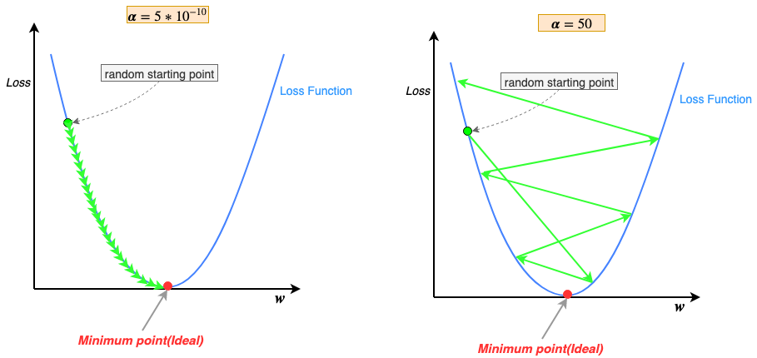
Effect of very low vs. high learning rate
Notes:
Small learning rate(α=5*10⁻¹⁰) resulting is numerous steps to reach the minimum point is self-explanatory; multiply gradient with a small number(α) results in a proportionally small step.
Large learning rate(α=50) causing gradient descent to diverge may be confounding, but the answer is quite simple; note that at each step gradient descent approximates its path downward by moving in straight lines(green arrows in the figures), in short, it estimates its path downwards. When the learning rate is too high we force gradient descent to take larger steps. Larger steps tend to overestimate the path downwards and shoot past the minimum point, then to correct the bad estimate gradient descent tries to move towards the minimum point but again overshoots past the minimum due to the large learning rate. This cycle of continuous overestimates eventually cause the results to diverge(Loss after each training cycle increase, instead of decrease).Learning rate is what’s called a hyper-parameter. Hyper-parameters are parameters that the neural network can’t essentially learn through backpropagation of gradients, they have to be hand-tuned according to the problem and its dataset, by the creator of the neural network model. (The choice of the Loss function, above, is also hyper-parameter)

Slide 44
Gradient Descent
Batch Gradient Descent
in one training iteration, it would reduce loss across all the training examples
mini-batch gradient descent
use a subset of the data set in each iteration
stochastic gradient descent
only use one example per training iteration
Epoch
A training iteration where the neural network goes through all the training examples

Slide 45
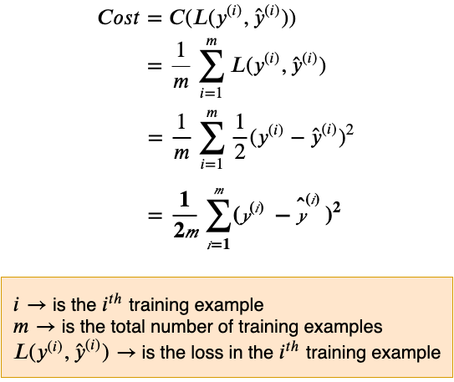
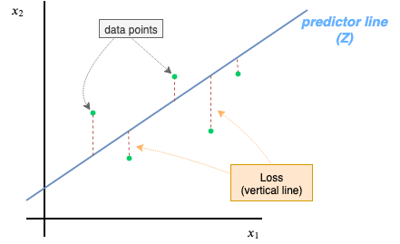
Cost Function

Slide 46
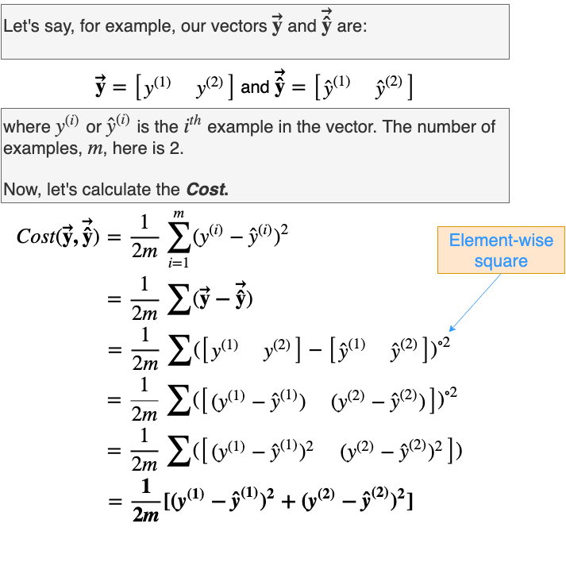

Slide 47
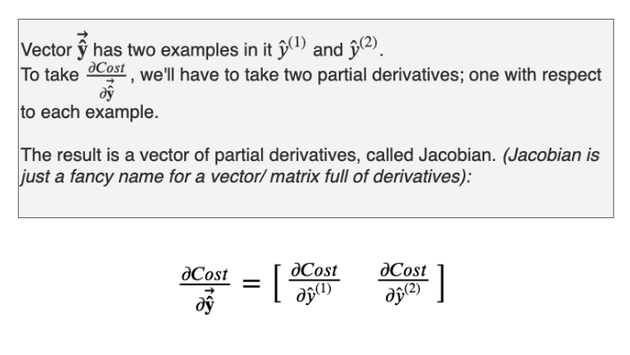

Slide 48
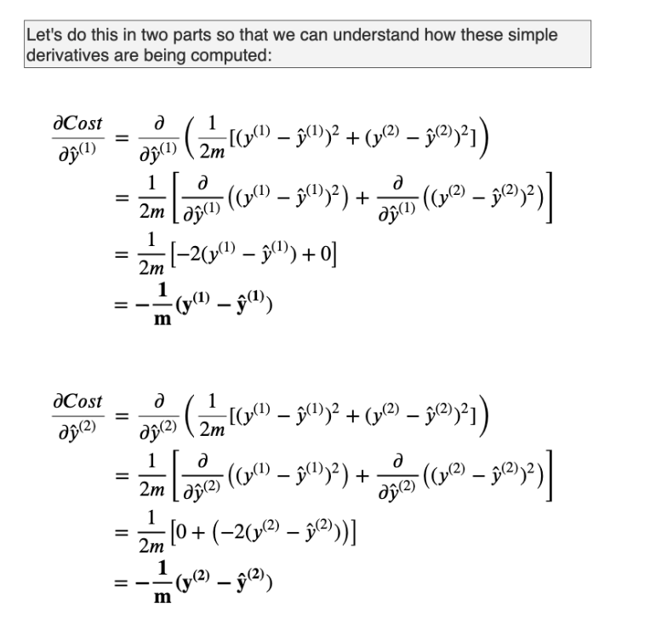

Slide 49


Slide 50

Loss vs Cost

Slide 51



Slide 52

Vectorized Implementation

Slide 53

Data Setup

Slide 54


Slide 55


Slide 56


Slide 57


Slide 58

Backward Propagation

Slide 59


Slide 60

Backward Propagation

Slide 62


Slide 63

Back Propagation

Slide 64


Slide 65


Slide 66


Slide 67

Forward Propagation

Slide 68

[0.037]

Slide 69

Cost - 2nd Iteration

Slide 70


Cost Curve and Decision Boundary after 5k Epochs

Slide 71
Continue...

Slide 72
References
https://end-to-end-machine-learning.teachable.com/
https://medium.com/towards-artificial-intelligence/nothing-but-numpy-understanding-creating-neural-networks-with-computational-graphs-from-scratch-6299901091b0

